Slide 1

Loan Approval Expert System
Batch No: 10
Subject: Artificial Intelligence
Slot: C11 + C12 + C14
Class Number: BL2025260101053
Fall Semester: 2025-26
Venue: AB02-415

Slide 2
Group Members
Siddhartha Parida (25MAS10023) - 50% Contribution
- Defined 50% of the rules, i.e. 25 rules in total for the knowledge base(KB).
- Built and worked on the logic of the model, i.e. on how the rules will be compared and updating of the scores.
Anirudh Narayanan (25MAS10011) - 50% Contribution
- Defined 50% of the rules, i.e. 25 rules in total for the knowledge base(KB)
- Built and worked on the input of applicants (information) to be compared with the knowledge base defined to produce an output showing all three applicant types (Approved, Denied and Manual Approval).

Slide 3
Agenda
Introduction
System Architecture
Knowledge Base
Inference Engine
Case Studies and Outputs
Advantages and Limitations
Future Aspects and Conclusion

Slide 4
Introduction
Manual loan approval is time-consuming and inconsistent.
Need for a systematic, unbiased, and efficient decision mechanism.
Our system is score-based, the scores are calculated as the system moves through rules.
Final categories by score:
Score > 10: Approved.
Score 0-10: Requires Manual Review.
Score < 0: Declined.

Slide 5
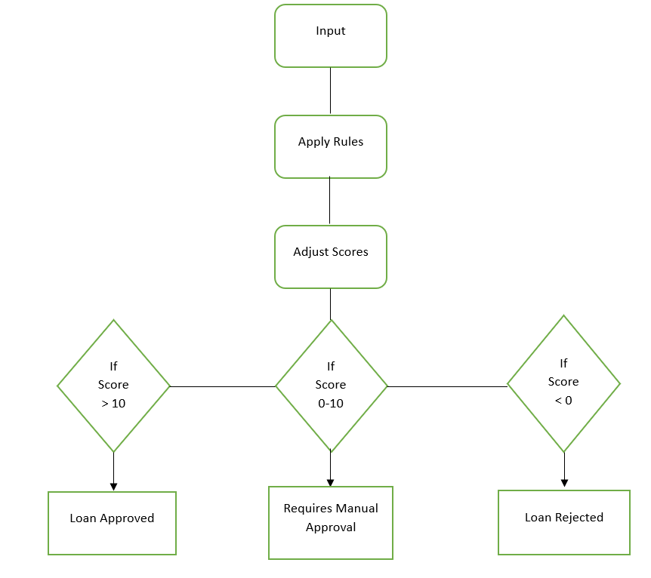
System Architecture
Forward-chaining, rule-based system.
Evaluates applicants using scores derived from their financial information.
50 IF-THEN rules covering credit, income, employment, debts and loan details.

Slide 6
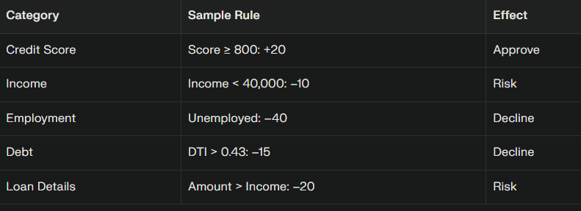
Knowledge Base
We have used a five-category Knowledge Base (KB) that covers all the important features for the expert system to compute a logically correct and decisive decision.

Slide 7
Category | Rule Name | IF Condition | THEN Action | Score
Credit Score and Bankruptcy | Excellent Score | Credit Score >= 800 | Adjust Score | +20
 | Very Good Score | 740 <= Credit Score < 800 | Adjust Score | +15
 | Good Score | 670 <= Credit Score < 740 | Adjust Score | +10
 | Fair Score | 580 ≤ Credit Score < 670 | Adjust Score | -5
 | Poor Score | Credit Score < 580 | Adjust Score | -25
 | Recent Bankruptcy | In last 7 yrs = True | Adjust Score | -30
 | No Recent Bankruptcy | In last 7 yrs = False | Adjust Score | +5
 | Multiple Recent Credit Inquiries | In last 2 yrs >= 5 | Adjust Score | -5
 | History of Late Payments | In last 2yrs >= 2 | Adjust Score | -10
 | No Late payments | In last 2yrs = 0 | Adjust Score | +5

Slide 8
Category | Rule Name | IF Condition | THEN Action | Score
2. Income & Employment | Very High Income | Credit Score >= 800 | Adjust Score | +20
 | High | 740 <= Credit Score < 800 | Adjust Score | +15
 | Moderate | 670 <= Credit Score < 740 | Adjust Score | +10
 | Low | 580 ≤ Credit Score < 670 | Adjust Score | -5
 | Stable Employment | Credit Score < 580 | Adjust Score | -25
 | Reasonably Stable | 2 ≤ Years at current job < 5 | Adjust Score | +5
 | New Employment | Years at current job < 2 | Adjust Score | +5
 | Unemployed | Employment Status = Unemployed | Adjust Score | -40
 | Self-Employed, High Earner | Employment Status = Self-Employed, Income ≥ 100,000 | Adjust Score | +5
 | Self-Employed, Low Earner | Employment Status = Self-Employed, Income < 100,000 | Adjust Score | -5

Slide 9
Category | Rule Name | IF Condition | THEN Action | Score
3. Debt & Financial Ratios | Very Low Debt-to-Income (DTI) Ratio | DTI Ratio < 0.20 | Adjust Score | +15
 | Low DTI Ratio | 0.20 ≤ DTI Ratio < 0.36 | Adjust Score | +10
 | Acceptable DTI Ratio | 0.36 ≤ DTI Ratio < 0.43 | Adjust Score | 0
 | High DTI Ratio | DTI Ratio > 0.43 | Adjust Score | -15
 | No Existing Loans | Has Existing Loan = False | Adjust Score | +5
 | Has Existing Loan | Has Existing Loan = True | Adjust Score | -5
 | Large Savings | Liquid Savings ≥ 50,000 | Adjust Score | +10
 | Moderate Savings | 10,000 ≤ Liquid Savings < 50,000 | Adjust Score | +5
 | Low Savings | Liquid Savings < 10,000 | Adjust Score | -5
 | High Credit Utilization | Credit Card Utilization > 0.5 | Adjust Score | -10

Slide 10
Category | Rule Name | IF Condition | THEN Action | Score
4. Loan Details | Small Loan Amount | Loan Amount < 10,000 | Adjust Score | +5
 | Large Loan Amount | Loan Amount > 250,000 | Adjust Score | -5
 | Debt Consolidation Loan Purpose | Loan Purpose = Debt Consolidation | Adjust Score | -5
 | Home Improvement Loan Purpose | Loan Purpose = Home Improvement | Adjust Score | +5
 | Business Loan Purpose | Loan Purpose = Business | Adjust Score | -10
 | Low Loan-to-Value Ratio | Loan-to-Value Ratio < 0.80 | Adjust Score | +10
 | High Loan-to-Value Ratio | Loan-to-Value Ratio > 0.95 | Adjust Score | +10
 | Short Loan Term | Loan Term (months) < 36 | Adjust Score | +5
 | Long Loan Term | Loan Term (months) > 60 | Adjust Score | -5
 | Loan Amount Exceeds Income | Loan Amount > Annual Income | Adjust Score | -20

Slide 11
Category | Rule Name | IF Condition | THEN Action | Score
5. Combined Risk Factors | Risk: Low Income + High DTI | Income < 40,000 AND DTI Ratio > 0.4 | Adjust Score | -20
 | Risk: Poor Credit + New Job | Credit Score < 600 AND Years at Job < 1 | Adjust Score | -20
 | Strength: High Income + Low DTI | Income ≥ 100,000 AND DTI Ratio < 0.2 | Adjust Score | +15
 | Strength: Excellent Credit + Stable Job | Credit Score ≥ 750 AND Years at Job ≥ 5 | Adjust Score | +15
 | Risk: Self-Employed + High DTI | Employment Status = Self-Employed AND DTI Ratio > 0.4 | Adjust Score | -10
 | Risk: Large Loan + Low Savings | Loan-to-Value Ratio < 0.80 | Adjust Score | Insufficient savings for requested loan
 | Risk: Past Bankruptcy + High DTI | Loan-to-Value Ratio > 0.95 | Adjust Score | -15
 | Applicant Too Young | Loan Term (months) < 36 | Adjust Score | -100
 | Non-Citizen Risk | Loan Term (months) > 60 | Adjust Score | Non-citizen status requires special review
 | Very High Risk Applicant | Loan Amount > Annual Income | Adjust Score | -50

Slide 12
Inference Engine
It scans each applicant’s facts and compares them against all 50 IF-THEN rules stored in the system’s knowledge base, using forward-chaining logic to select applicable rules.
For every rule whose IF condition matches the applicant’s profile, the THEN action fires—typically adjusting a decision score or adding reasoning to the evaluation.
After processing all relevant rules, the engine calculates a final score, and based on predefined thresholds, assigns the loan verdict: “Approved,” “Declined,” or “Requires Manual Review”.

Slide 13
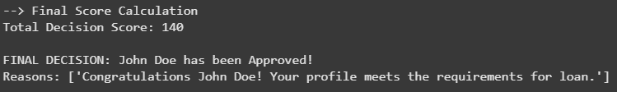
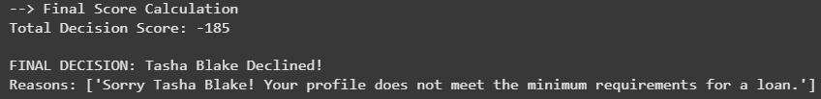
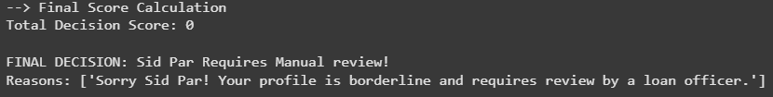
Case Studies and Outputs
Case Study 1: Strong Applicant
Name: John Doe
High score
(Credit = 810, Income = 160,000, Low DTI).
Decision: Approved (Score: 140).
Case Study 2: Weak Applicant
Name: Tasha Blake
Poor credit (550), low income,
high debt, recent bankruptcy.
Decision: Declined (Score: –185).
Case Study 3: Borderline Applicant
Name: Sid Par
Decent credit (680),
moderate income, but self-employed, high DTI.
Decision: Review (Score: 0).

Slide 14
Advantages and Limitations
Faster, consistent decision-making.
Transparent reasoning.
Handles large applications with minimal bias.
Rule inflexibility (cannot adapt to unseen scenarios).
Requires periodic updates.
Borderline cases still need human review.

Slide 15
Future Aspects and Conclusion
Integration of real-time data feeds such as credit bureau APIs to get up-to-date applicant financial data.
Deployment of intuitive web-based interfaces for applicants and financial officers for smoother user experience.
Addition of fraud detection, risk assessment, and automated post-disbursement loan servicing features.
Use of alternative data sources and behavioral analytics to enhance financial inclusion for underserved populations.
Ensures consistent, unbiased decisions by applying objective financial criteria like credit score, income, employment, and debt ratios.
Provides transparent explanations for decisions by showing which rules influenced the outcome.
Handles a large volume of applications efficiently, reducing manual workload and errors.
While highly effective, the system requires periodic updates and human review for borderline or complex cases.
The expert system enhances the overall reliability and fairness in loan approvals, improving customer satisfaction and operational efficiency.

Slide 16
Thank You

